Slide 1

Introduction to Coding Environments for Python
Session 02

Slide 2



Our Mission
Inspiring women to
excel in technology
careers.

Slide 3

Our Vision
A world where diverse women are better represented as engineers and tech leaders

Slide 4

Our Target
Engineers with two or more years of experience looking for support and resources to strengthen their influence and levelup in their careers.

Slide 5

290,000
Members
70 networks in 20 countries
122+ countries
14K+ events
$1025 daily Conference tickets
$2M Scholarships
Access to jobs + resources
Infinite connections
Notes:
290,000 and growing!

Slide 6
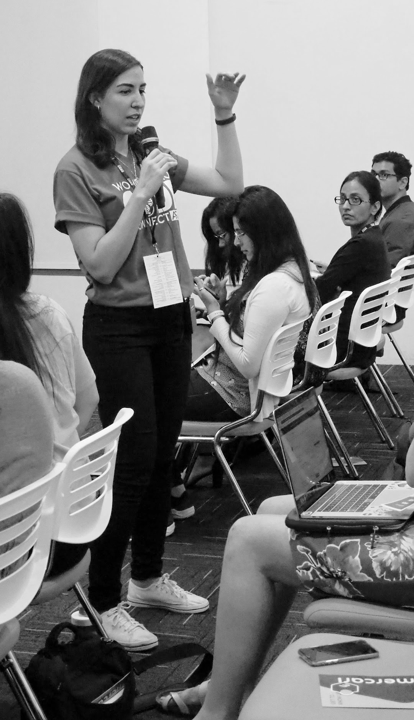
OUR MOVEMENT
As the world changes, we can be a connecting force that creates a sense of belonging while the world is being asked to isolate.
Notes:
Since the world pandemic WWCode have made a new movement statement.

Slide 7
Code of Conduct
WWCode is an inclusive community, dedicated to providing an empowering experience for everyone who participates in or supports our community, regardless of gender, gender identity and expression, sexual orientation, ability, physical appearance, body size, race, ethnicity, age, religion, socioeconomic status, caste, creed, political affiliation, or preferred programming language(s).
Our events are intended to inspire women to excel in technology careers, and anyone who is there for this purpose is welcome. We do not tolerate harassment of members in any form. Our Code of Conduct applies to all WWCode events and online communities.
Read the full version and access our incident report form at womenwhocode.com/codeofconduct
Notes:
Let the participants know that our Code Of Conduct applied to all events and online communities and if they want to read the full version to visit the link.

Slide 8
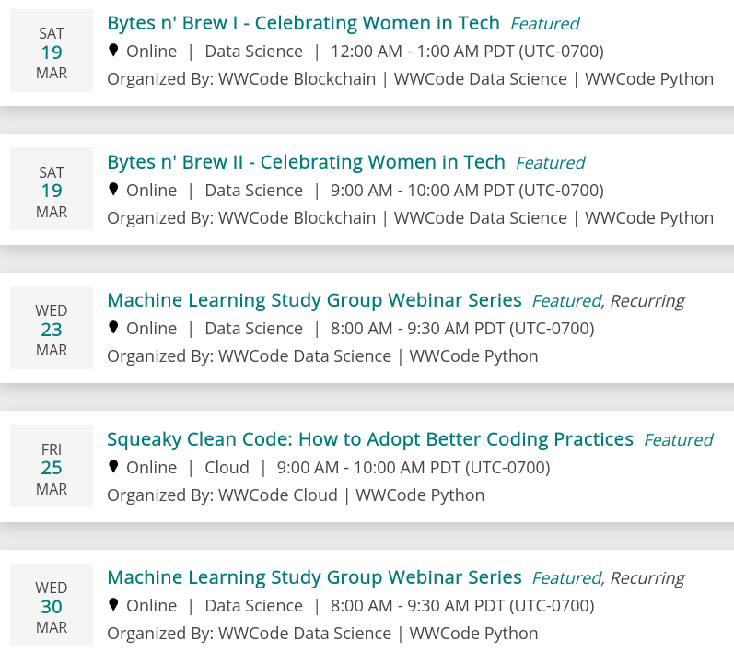
Upcoming Events
Notes:
Add any upcoming events to the slides and send womenwhocode.com/datascience/events to webinar chat box

Slide 9




Follow us
Register for Events and Join our community - womenwhocode.com/python
Email - python@womenwhocode.com
Social Media:⬇
@WWCodePython
Women Who Code Python
@WWCodePython
/WWCodePython
Notes:
Send links to all social media accounts in the webinar chat

Slide 10



Poojita Garg
Jessica Koubi
Nayeon
Introduction to Coding Environments for Python
Session 2

Slide 11
Hi! I’m Jessica
linkedin.com/in/jessicakoubi

Slide 12
Computer program that edits plain text
Can edit any type of code
Come with your OS
Vi: MacOS/Some Linux
Nano: MacOS/Linux/Unixes
Notepad: Windows
What are text editors?
Notes:
Q of the day - what’s your favorite snack

Slide 13
Consume less hardware resources
Language agnostic
Simpler to use (usually)
Don’t hide inner workings
Sometimes heavily customizable
Pros
Notes:
Q of the day - what’s your favorite snack

Slide 14
No built-in debugger or profiler
No intelligent code editing or smart code navigation
No all-in-one package integration
Sometimes harder to work on multiple files at once
Cons
Notes:
Q of the day - what’s your favorite snack

Slide 15

Vim
Emacs
Notepad++
Sublime Text
Atom
Notepad
TextMate
Some Text Editors
Notes:
Q of the day - what’s your favorite snack

Slide 16
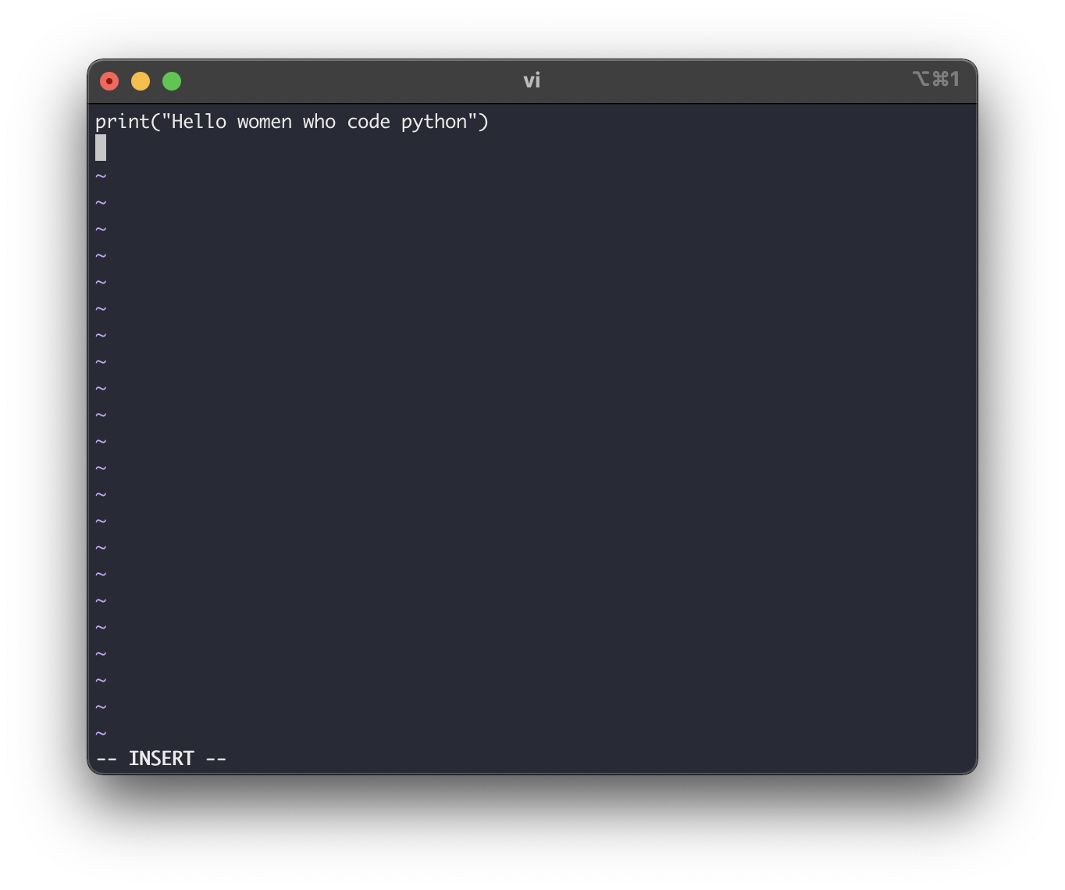
A Look At Vim
Notes:
Q of the day - what’s your favorite snack

Slide 17
Highly configurable and extensible text editor.
Pre Installed on MacOS and some Linux.
Can be installed on most operating systems: vim.org
Run in command-line.
Everything can be done with a keyboard.
Many IDEs and text editors have a Vim emulation mode
Learn shortcuts once, switch between IDEs/Editors easily.
What Is Vim?
Notes:
Q of the day - what’s your favorite snack

Slide 18
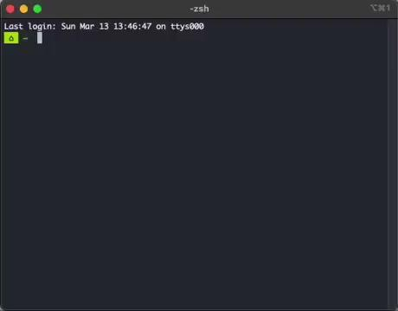
Type vi in a terminal.
Starting Vim
Notes:
Q of the day - what’s your favorite snack

Slide 19
Vim Modes
NORMAL | INSERT | COMMAND | VISUAL
Default mode Navigate in a file Perform operations on the text (delete, copy/paste, etc) | Type text | Open/Save a file Find/Replace text Undo/Redo Vim help Play golf And many more ! | Create text selections Perform operations on the selection (indent, delete, change, etc).
Notes:
Q of the day - what’s your favorite snack

Slide 20
Type Escape to go to NORMAL mode.
Motions
Characters: h, l
Words: w, e, b
Lines: j, k, 0, $
Code Blocks: {, }
Count
3 Words: 3w
5 Lines: 5j
Navigate In Your Code
Notes:
Q of the day - what’s your favorite snack

Slide 21
Jump to line 122: 122G
Go half-way in your file: 50%
Go start/end of line: 0, $
Next instance of word under cursor: *
Navigate In Your Code By Example
Notes:
Q of the day - what’s your favorite snack

Slide 22
Operations
Delete: d
Delete Line: dd
Yank (Copy)/Paste: y, p
Operator+[count]+motion
Operator: What do do
Count: Optional, repeat the motion
Motion: Move over text to operate on
Repeat the last command with dot: .
Operate On Your Code
Notes:
Q of the day - what’s your favorite snack

Slide 23
Copy five lines down: y5j
Delete word and go to INSERT: ce
Delete next 3 words: d3w
Operations Examples
Notes:
Q of the day - what’s your favorite snack

Slide 24
Press i to go into INSERT mode
Insert after cursor: a
Insert at start of line: I
Insert at end of line: A
Insert in new line below: o
Insert in new line above: O
Delete word with Ctrl+w
Type Text
Notes:
Q of the day - what’s your favorite snack

Slide 25
Go to NORMAL mode.
Use : to enter COMMAND mode.
Show line number: :set nu
Save file: :w
Save and exit: :wq
Edit file my_script.py: :e my_script.py
Show tree (plugin): :NERDTree
Substitute foo with bar: :s/foo/bar/g
Substitute foo with bar and confirm: :s/foo/bar/c
Use Commands
Notes:
Q of the day - what’s your favorite snack

Slide 26
Search forward/backward for None: \None, ?None
Press n to go to the next match, N for the previous one.
Ignore case with :set ic and go back with :set noic
Use case-sensitive search when you type a capital with :set smartcase
Search Text
Notes:
Q of the day - what’s your favorite snack

Slide 27
Go into VISUAL mode.
Character: v
Block: Ctrl+v
Line: V
Use motions seen in NORMAL mode to highlight or select text.
Yank, Delete and Copy operations will work on the selection.
The substitute command will work as well.
Highlight/Select Text
Notes:
Q of the day - what’s your favorite snack

Slide 28
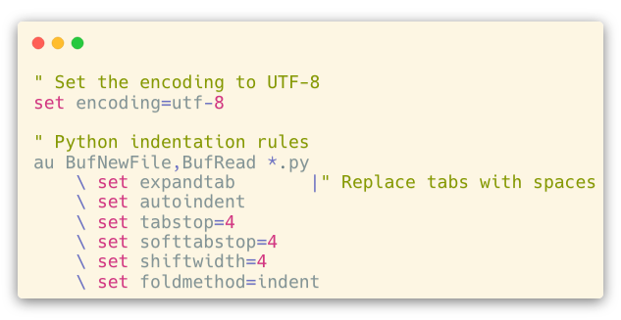
Create a .vimrc file in your $HOME directory
Set encoding and some indentation rules
Configure Vim For Python
Notes:
Q of the day - what’s your favorite snack

Slide 29
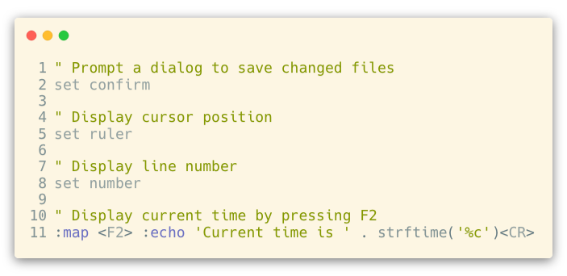
Additional configuration
Notes:
Q of the day - what’s your favorite snack

Slide 30
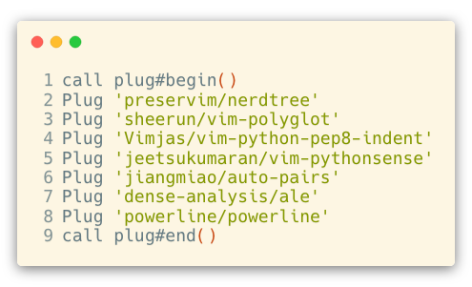
Install vim-plug: github.com/junegunn/vim-plug
Install Plugins
Notes:
Q of the day - what’s your favorite snack

Slide 31

vimgolf.com
Play Golf
Notes:
Q of the day - what’s your favorite snack

Slide 32
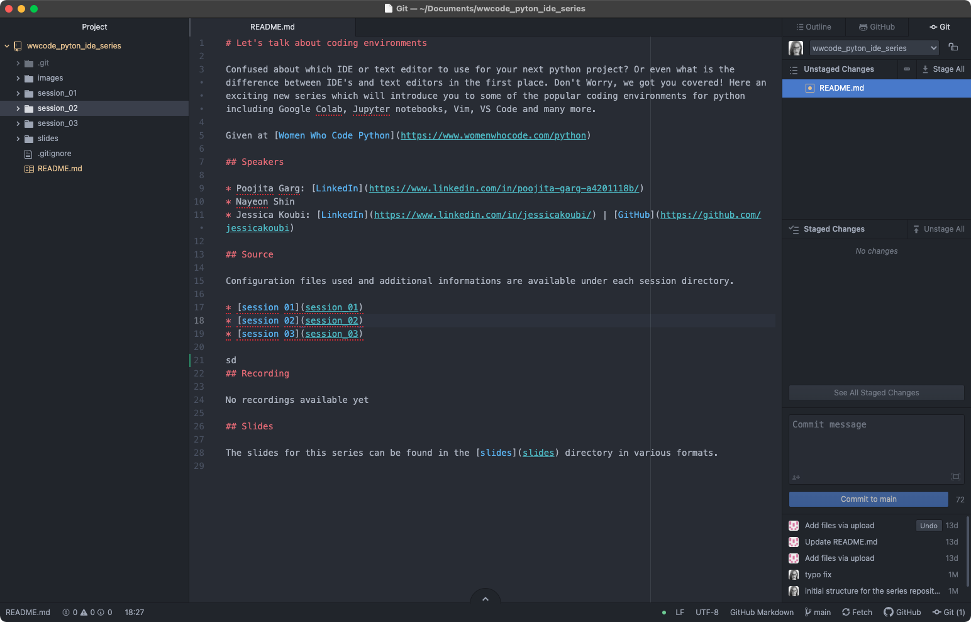
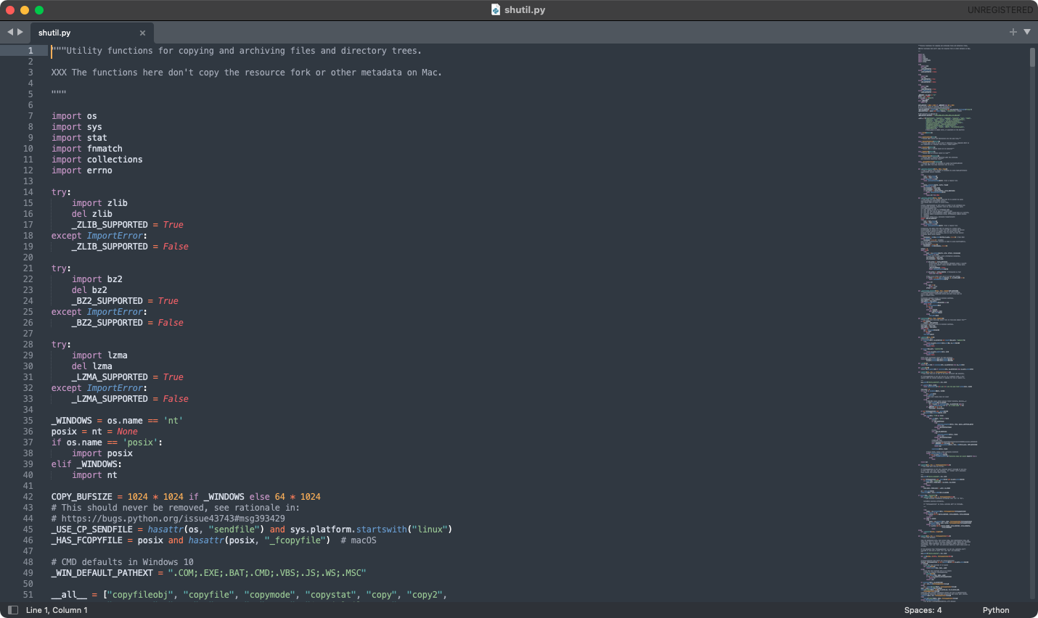
A Brief Look At Atom And Sublime
atom.io
sublimetext.com
Notes:
Q of the day - what’s your favorite snack

Slide 33
Upcoming in the Series
Session 3 on IDEs on 1 April @ 8 PM ET

Slide 34
Q&A

Slide 35

Stay Connected
Find more resources related to this talk on github.com/WomenWhoCode/WWCodePython
For additional questions, join our slack channel

